Slide 1
Project 1: GDP vs. COVID
UCI – Boots camp - Data Analytics
Fall 2021
Professor: Saivash Mortezavi
TA:Tarique Shams
Prepared By:
Joshua Pardo
Jonathan Rivera
Jenny Bui
HoangYen Cao
Date October 30, 2021

Slide 2
Finding Process
Collected Dataset from https://www.kaggle.com/deepshah16/covid19-dataset
Python, Jupyter Notebook and Pandas.
Matplotlib to enhance data comparison
STEP
03
STEP
02
STEP
01

Slide 3
We analysed the following:
1. GDP /capita vs. Vaccination/capita
2. GDP/capita vs. Total Death/capita
GDP/capita vs. Total Cases
Highest and Lowest GDP Rates

Slide 4
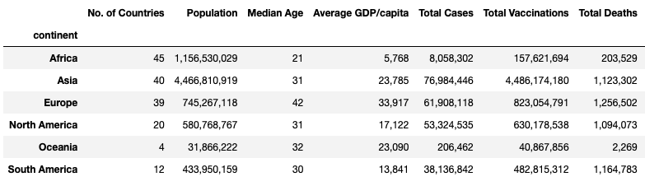
GDP vs. COVID Summary

Slide 5
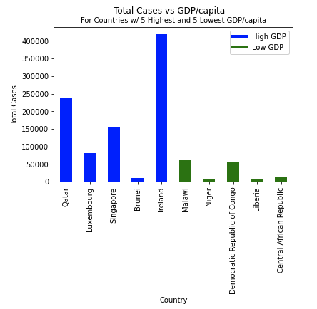
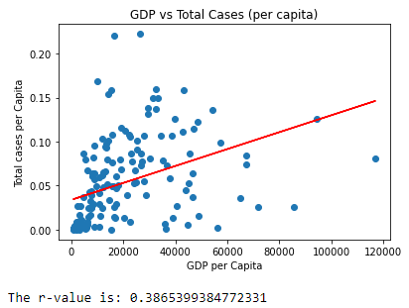
GDP vs. Total Cases(per Capita)

Slide 6
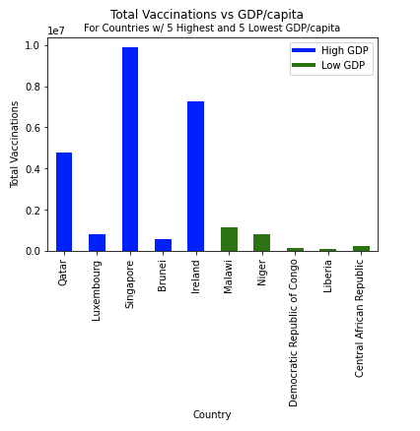
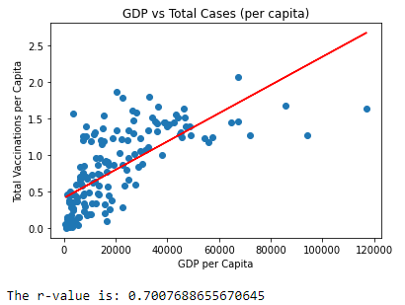
GDP vs. Vaccination(per Capita)

Slide 7
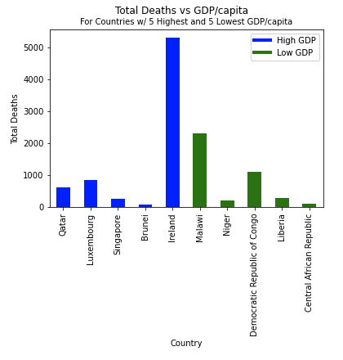
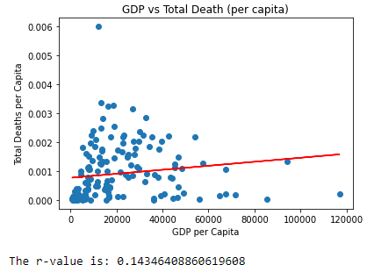
GDP vs. Capita vs Total Death/Capita

Slide 8
Conclusion

Slide 9
Q&A?

